Slide 1
DeepPurple
PI: Vahid Tarokh*
Yu Xiangº, Yuting Sunº, Enmao Diaoº, Jie Ding*
* Duke University -- ECE
º Harvard University -- SEAS

Slide 2
Duke Data: Overview

Slide 3
Duke Data: Main Question
Goal: Predict infection after the inoculation within shortest time range
Key consideration:
it is ideal to have good prediction accuracy based only on low-cost data
Main Question: How to make correct prediction within 24 hours after inoculation based only on low-cost data ?

Slide 4
Results Summary
We develop a random forest based method to make prediction
Features of our method
Designed to handle data with periodicity
Require no prior domain knowledge of the data
Main result: Our method achieves 80% prediction accuracy based only on low-cost data.

Slide 5
Duke Data
Focus on: Physiological sensor data – low-cost data
Physiological sensor data (wearable device):
Electro-dermal activity (EDA),
Heart rate (HR)
Skin temperature (Temp)
Features of physiological sensor data
Easy to collect and low expense
Less informative

Slide 6
Duke Data: Main Challenge
Main challenge: lack of data
Only 21 subjects
Due to missing data, only 18 subjects can be studied.
Limited data is available for 3 of subjects
Before inoculation, only two days of complete data is available.

Slide 7
Our Approach
Our approach:
Develop a Random Forest based method to make prediction
Use the prediction errors as the features
Key consideration: The model must make use of the (rough) periodicity of the data to make inference
Main result: We achieve about 80% accuracy within 24 hours based only on low-cost data

Slide 8
Two Approaches
Propose two approaches based on random forest
The first approach serves as a preliminary model, which shows some promising features but is not quite robust to initialization
The second approach is an improvement of the first approach to make the model more robust to initialization

Slide 9
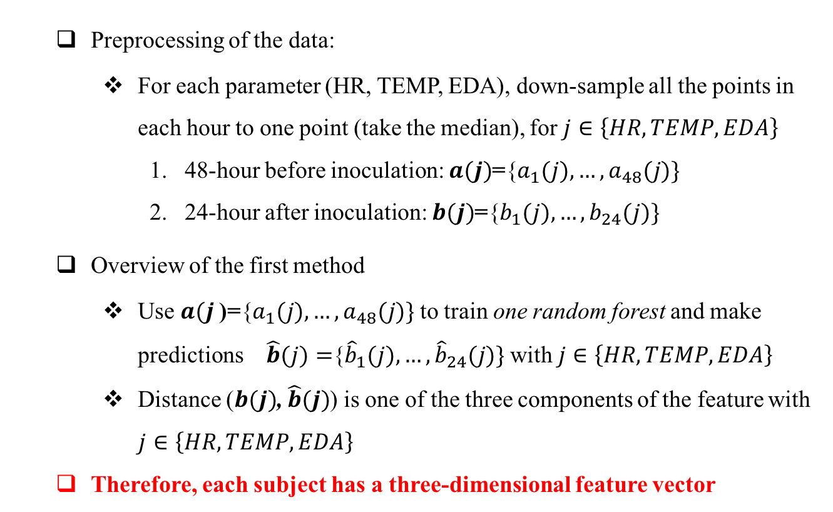
First Approach
Preprocessing of the data:
For each parameter (HR, TEMP, EDA), down-sample all the points in each hour to one point (take the median), for $j∈\left\{HR,TEMP,EDA\right\}$
48-hour before inoculation: $a(j)$={$a_{1}(j),…,a_{48}(j)\}$
24-hour after inoculation: $b(j)$={$b_{1}(j),…,b_{24}(j)\}$
Overview of the first method
Use $a(j$)={$a_{1}(j),…,a_{48}(j)\}$ to train one random forest and make predictions $\hat{b}(j)=${${\hat{b}}_{1}(j),…,{\hat{b}}_{24}(j)\}$ with $j∈\left\{HR,TEMP,EDA\right\}$
Distance ($b(j)$, $\hat{b}(j)$) is one of the three components of the feature with $j∈\left\{HR,TEMP,EDA\right\}$
Therefore, each subject has a three-dimensional feature vector

Slide 10
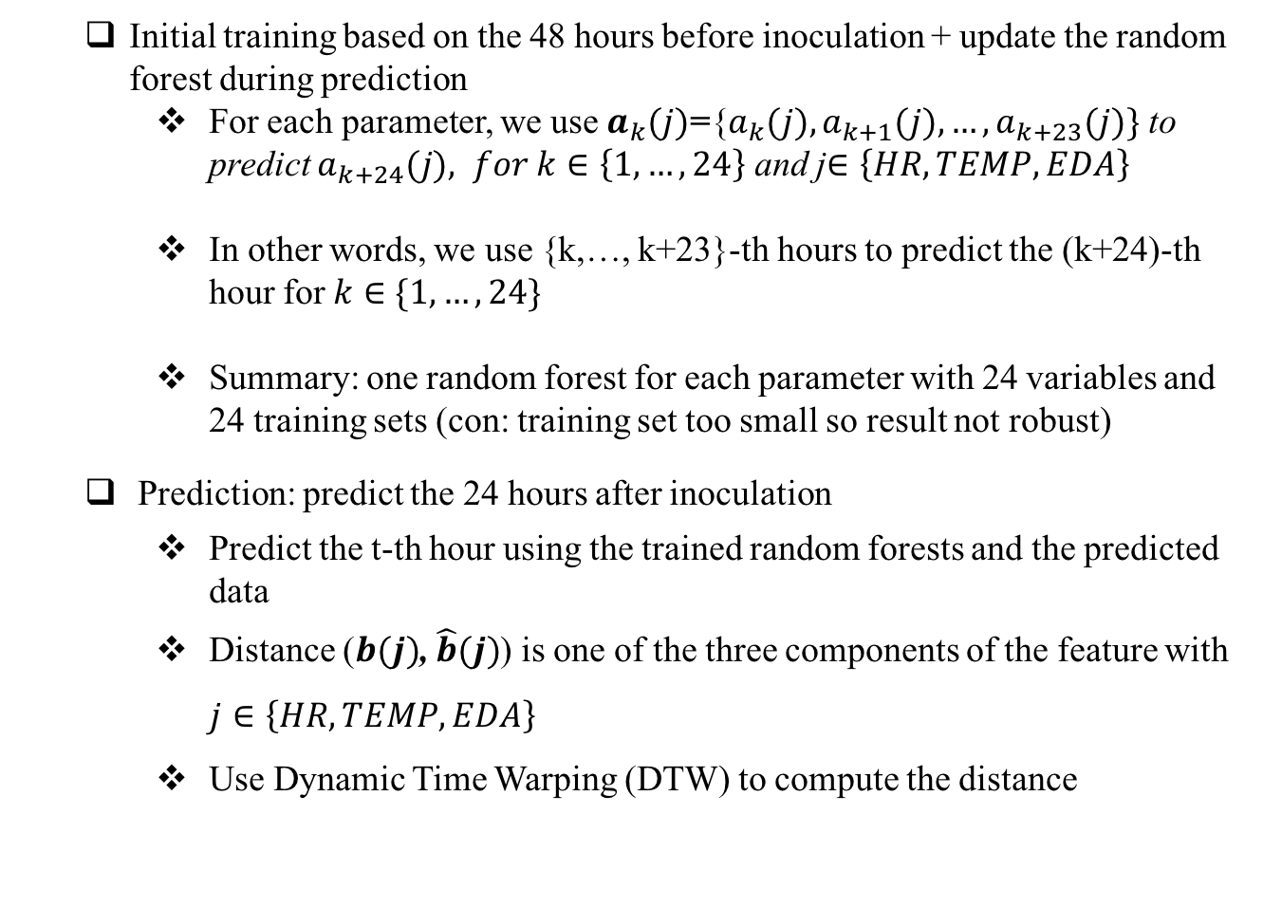
Details of the First Approach
Initial training based on the 48 hours before inoculation + update the random forest during prediction
For each parameter, we use $a_{k}(j)$={$a_{k}(j),a_{k+1}(j),…,a_{k+23}(j)\}$ to predict $a_{k+24}(j), for k∈\left\{1,…,24\right\}$ and j$∈\left\{HR,TEMP,EDA\right\}$
In other words, we use {k,…, k+23}-th hours to predict the (k+24)-th hour for $k∈\{1,…,24\}$
Summary: one random forest for each parameter with 24 variables and 24 training sets (con: training set too small so result not robust)
Prediction: predict the 24 hours after inoculation
Predict the t-th hour using the trained random forests and the predicted data
Distance ($b(j)$, $\hat{b}(j)$) is one of the three components of the feature with $j∈\left\{HR,TEMP,EDA\right\}$
Use Dynamic Time Warping (DTW) to compute the distance

Slide 11
Issues with the First Approach
Training set too small compared with the number of features
Main improvements:
Increase training set by making better use of the data (down-sample to 1 point per minute)
Take into account the (rough) periodicity of the data

Slide 12
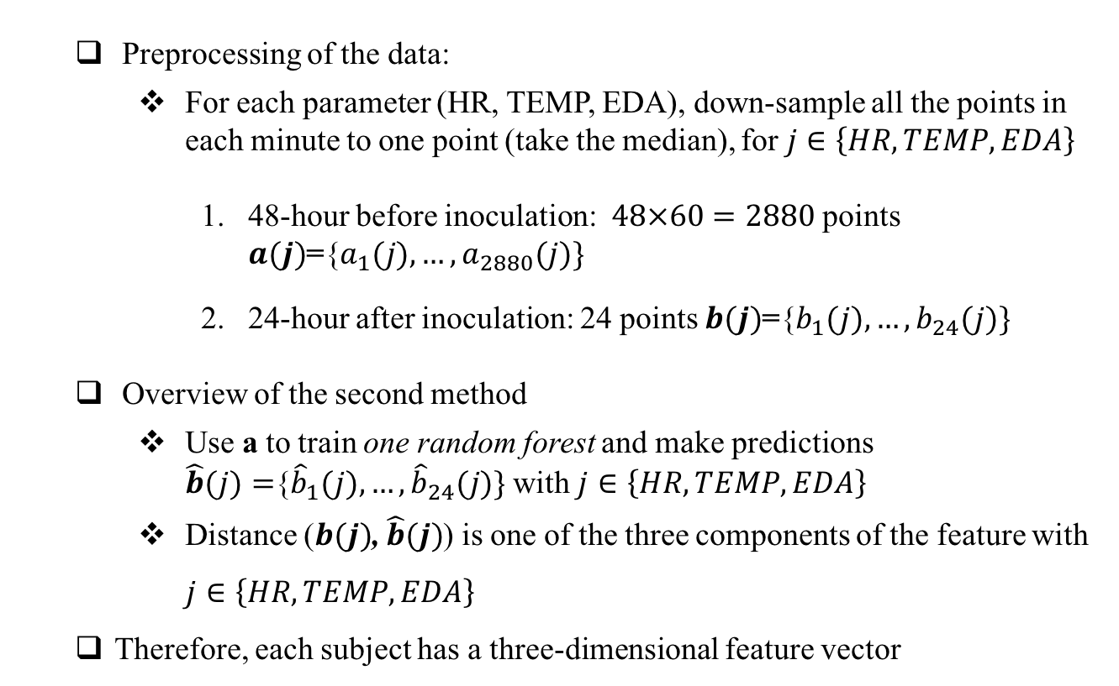
Second Approach
Preprocessing of the data:
For each parameter (HR, TEMP, EDA), down-sample all the points in each minute to one point (take the median), for $j∈\left\{HR,TEMP,EDA\right\}$
48-hour before inoculation: $48×60=2880$ points $a(j)$={$a_{1}(j),…,a_{2880}(j)\}$
24-hour after inoculation: 24 points $b(j)$={$b_{1}(j),…,b_{24}(j)\}$
Overview of the second method
Use a to train one random forest and make predictions $\hat{b}(j)=${${\hat{b}}_{1}(j),…,{\hat{b}}_{24}(j)\}$ with $j∈\left\{HR,TEMP,EDA\right\}$
Distance ($b(j)$, $\hat{b}(j)$) is one of the three components of the feature with $j∈\left\{HR,TEMP,EDA\right\}$
Therefore, each subject has a three-dimensional feature vector

Slide 13
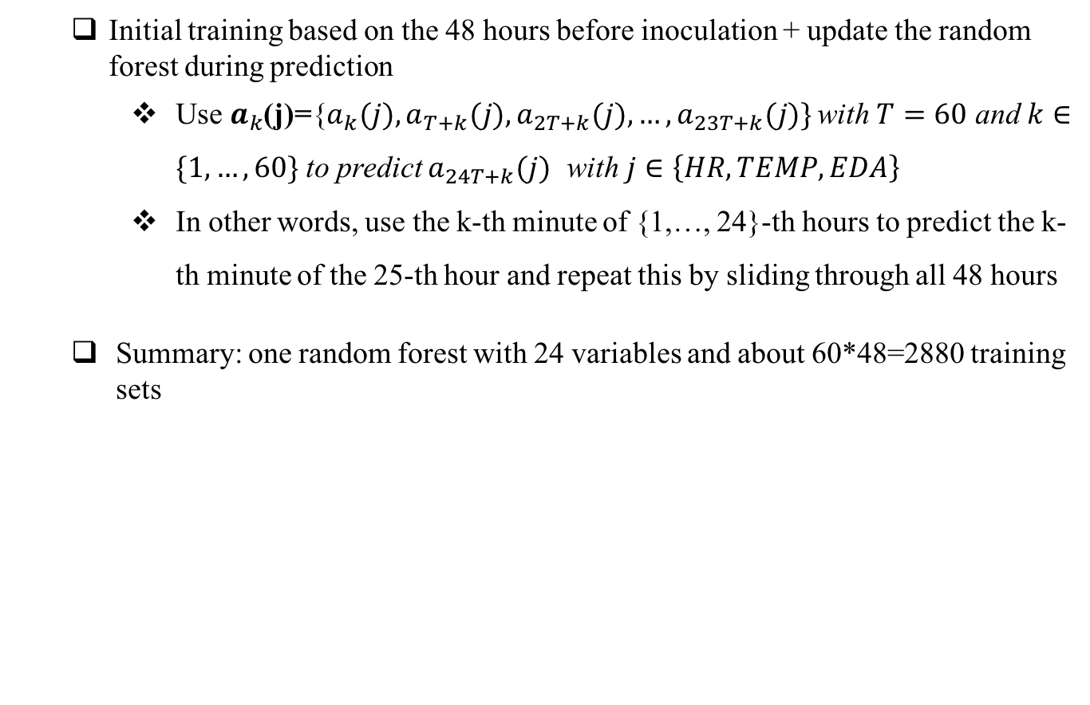
Second Approach: Details
Initial training based on the 48 hours before inoculation + update the random forest during prediction
Use $a_{k}$(j)={$a_{k}(j),a_{T+k}(j),a_{2T+k}(j),…,a_{23T+k}(j)\}$ with $T=60$ and $k∈\{1,…,60\}$ to predict $a_{24T+k}(j)$ with $j∈\left\{HR,TEMP,EDA\right\}$
In other words, use the k-th minute of {1,…, 24}-th hours to predict the k-th minute of the 25-th hour and repeat this by sliding through all 48 hours
Summary: one random forest with 24 variables and about 60*48=2880 training sets
Inoculation
1
2
3
24
25
48

Slide 14
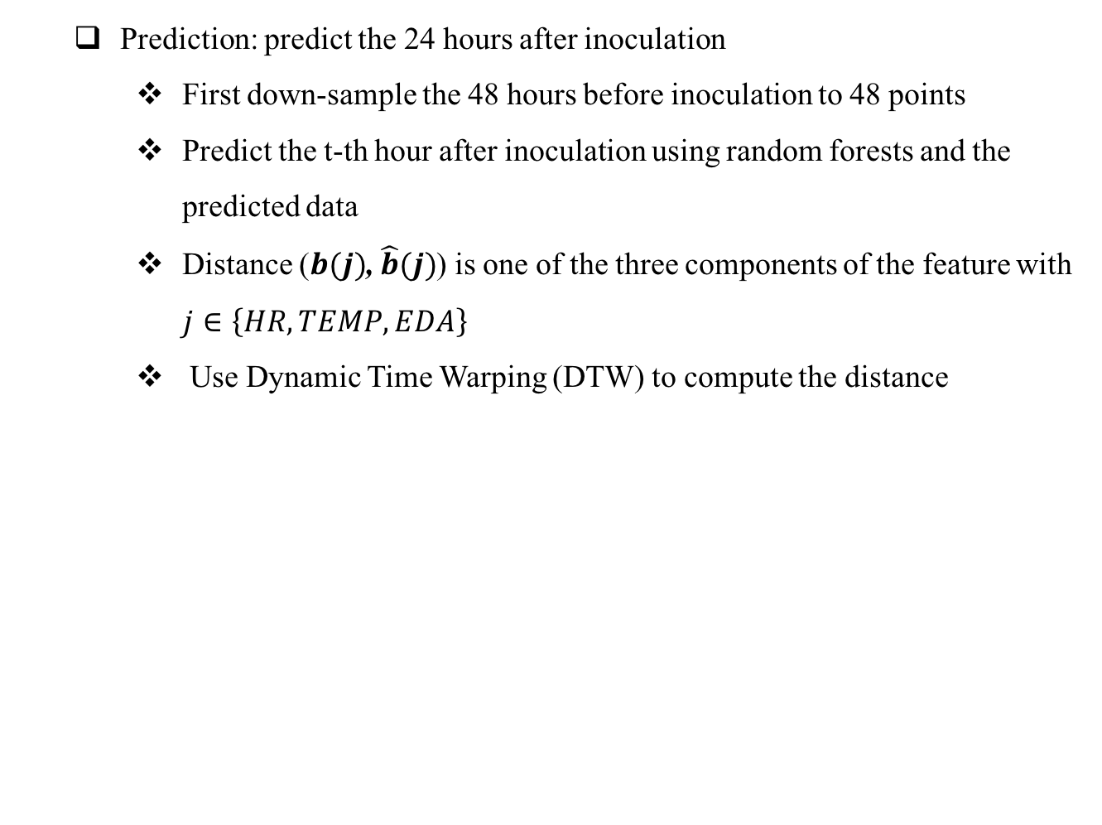
Second Approach: Details
Prediction: predict the 24 hours after inoculation
First down-sample the 48 hours before inoculation to 48 points
Predict the t-th hour after inoculation using random forests and the predicted data
Distance ($b(j)$, $\hat{b}(j)$) is one of the three components of the feature with $j∈\left\{HR,TEMP,EDA\right\}$
Use Dynamic Time Warping (DTW) to compute the distance
Inoculation
1
2
3
1
2
24
24

Slide 15
Summary Results
True label (infected or not) is based on symptom and shedding values
8 non-infected subjects and 10 infected subjects
Use simple classification method: SVM
Use cross validation to evaluate the performance

Slide 16
Summary Results
Move the whole training and testing window (a 3-day window) to the right for 5 consecutive hours (step-size is 1 hour)
Did not move the window to the left due to lack of data

Slide 17
Summary Results
Decompose two types of errors:
false positive rate = # false positive / total # of non-infected
false negative rate = # false negative / total # of infected

